Slide 1
MICROCONTROLLER BASED OBSTACLE AVOIDING ROBOT
Group Members: Fatima Nazir, Ayesha Khan
Submitted to: Dr. Raheel Qureshi

Slide 2
INTRODUCTION
The automatic obstacle avoiding robot is a smart robot built using an arduino uno, an ultrasonic sensor and wheel actuators.
The code consists of two parts, the setup() function, which runs only one time and is used to initialize the direction of the servo motor to a forward facing (90 degree) angle. The loop () function, which runs an infinite number of times and is used to move the robot in forward direction while also continuously reading the distance of ultrasonic sensor from any nearby obstacle (if present). Some other additional user defined functions are also implemented to move forward or backward and make turns.

Slide 3
AIMS AND OBJECTIVES
To design a smart obstacle avoiding car that has the ability to detect an object in its path, change direction and follow a new path around that object.
To keep the project as simple and cost effective as possible.
To cover any lagging factors from the previous implementations of this project done by other people.
To keep it fully automated, so there is no requirement of an external control.

Slide 4
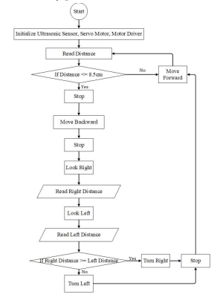
METHODOLOGY
FLOW CHART

Slide 5
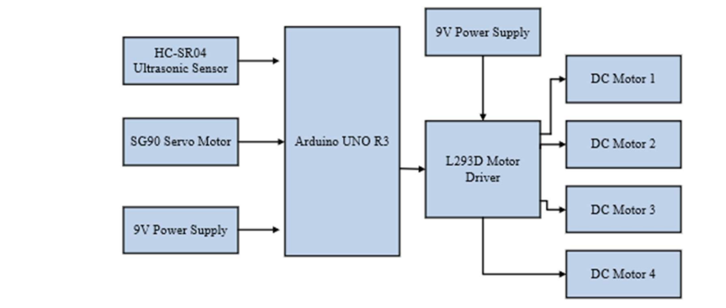
BLOCK DIAGRAM

Slide 6
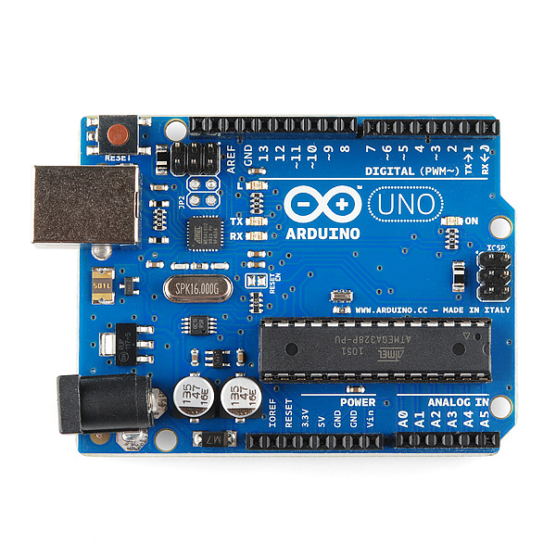
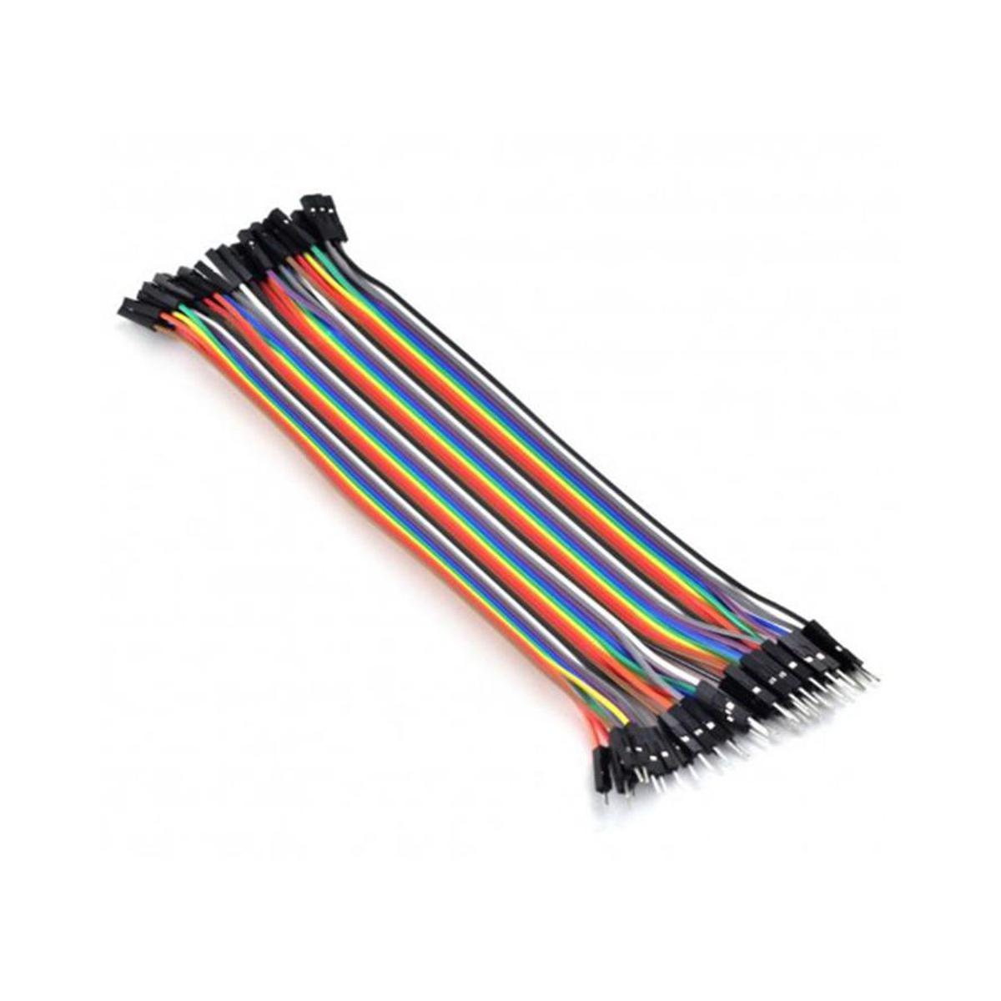
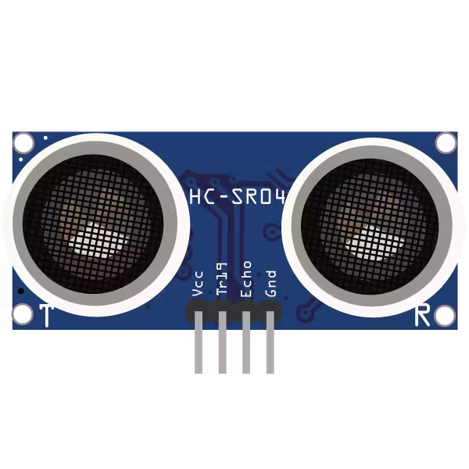
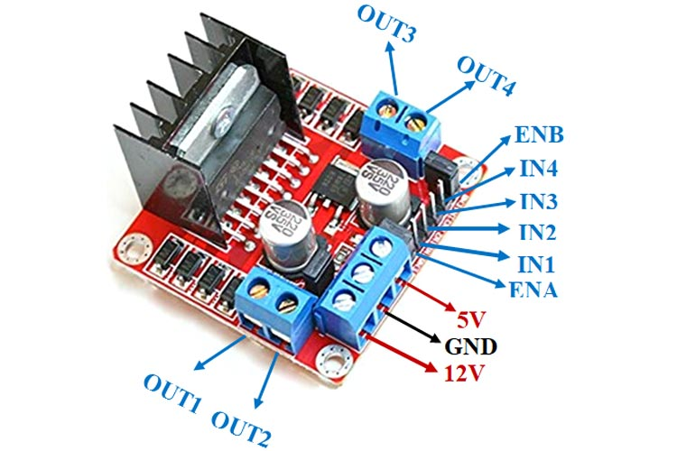
COMPONENTS
L298 Motor Driver Arduino Uno Ultrasonic sensor jumper wires

Slide 7
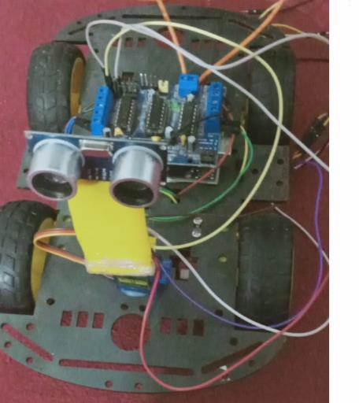
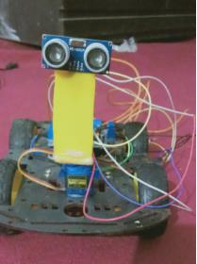
HARDWARE SETUP

Slide 8
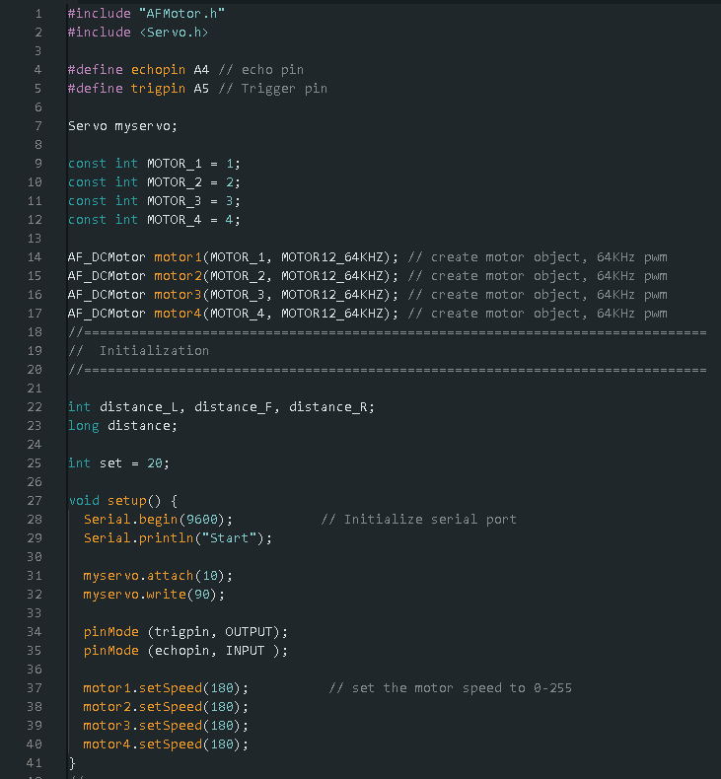
CODE

Slide 10
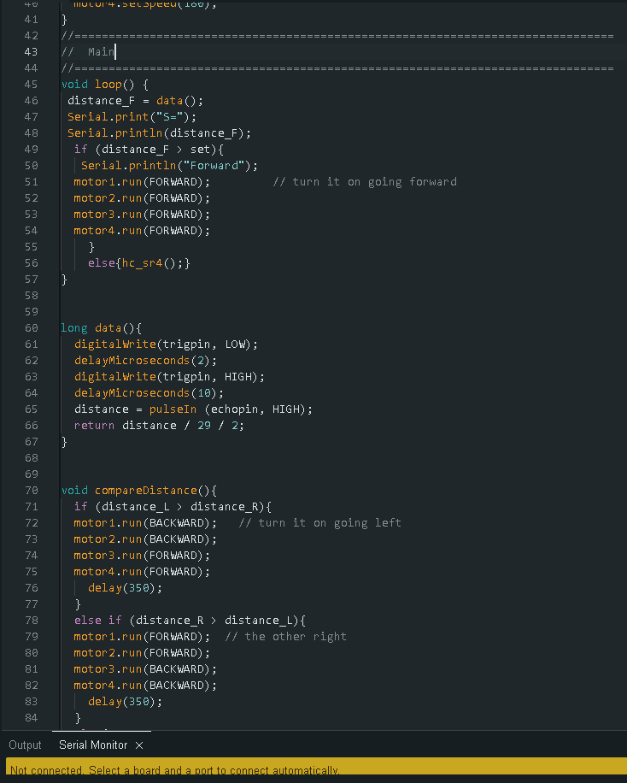

Slide 12
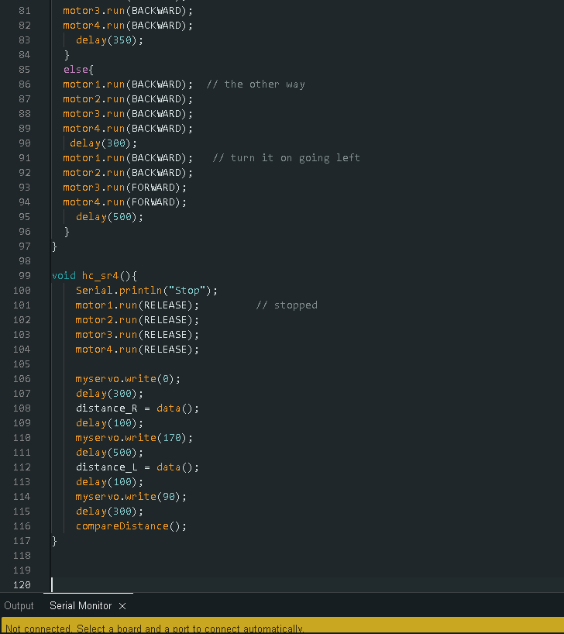

Slide 14
CONCLUSION
Hence a working prototype of an obstacle avoiding car was obtained which was tested on the lab ground and debugged for errors.

Slide 15
REFERENCES
[1] Y. Jin, S. Li, J. Li, H. Sun and Y. Wu, "Design of an Intelligent Active Obstacle Avoidance Car Based on Rotating Ultrasonic Sensors," 2018 IEEE 8th Annual International Conference on CYBER Technology in Automation, Control, and Intelligent Systems (CYBER), Tianjin, China, 2018, pp. 753-757, doi: 10.1109/CYBER.2018.8688326.

